Slide 1

Cyber Defense Organization
Fall 2018 Informational

Slide 2
Who?
You looked

Slide 3
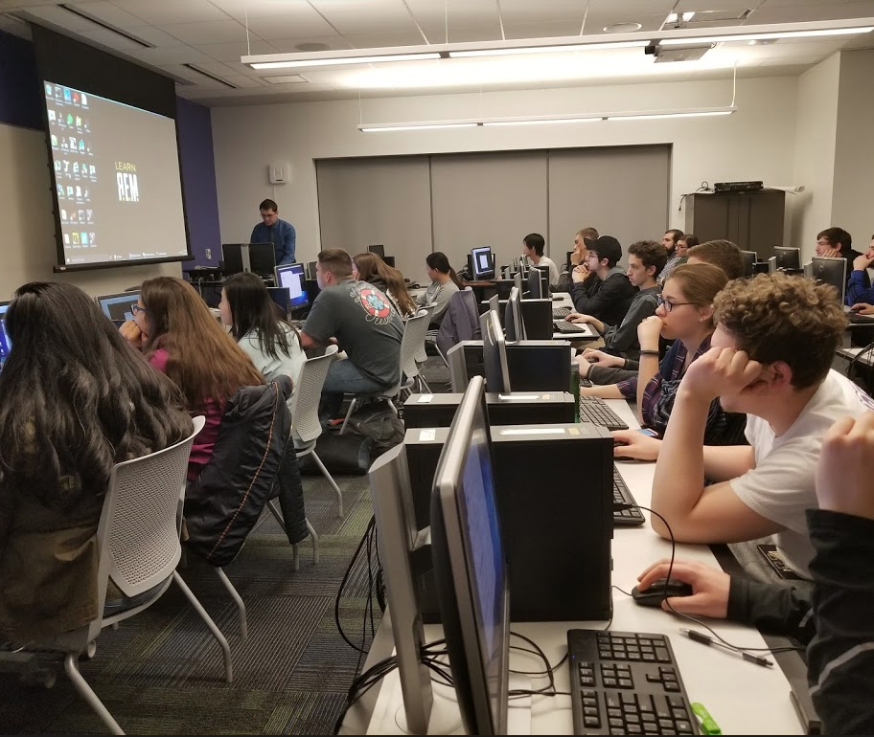
We Are the Cyber Defense Organization
Sharing Practical Skills for Practical Situations. Our purpose is to help train students in the fundamentals of cybersecurity, and train for different competitions such as CCDC and other local events.

Slide 4
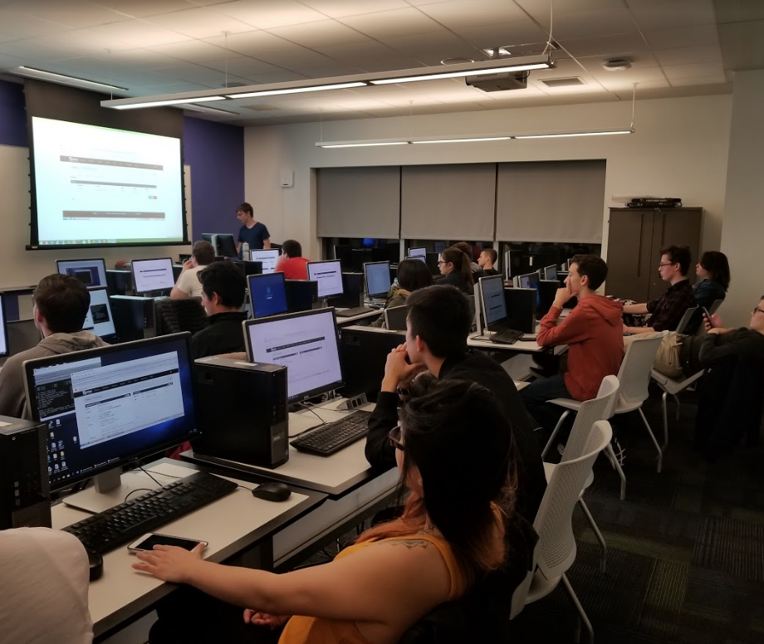
Workshops
Every week we hope to introduce a technical topic related to cybersecurity and have you work with it.

Slide 5

Competitions
The mission of the Collegiate Cyber Defense Competition (CCDC) system is to provide institutions with an information assurance or computer security curriculum a controlled, competitive environment to assess their student's depth of understanding and operational competency in managing the challenges inherent in protecting a corporate network infrastructure and business information systems.

Slide 6
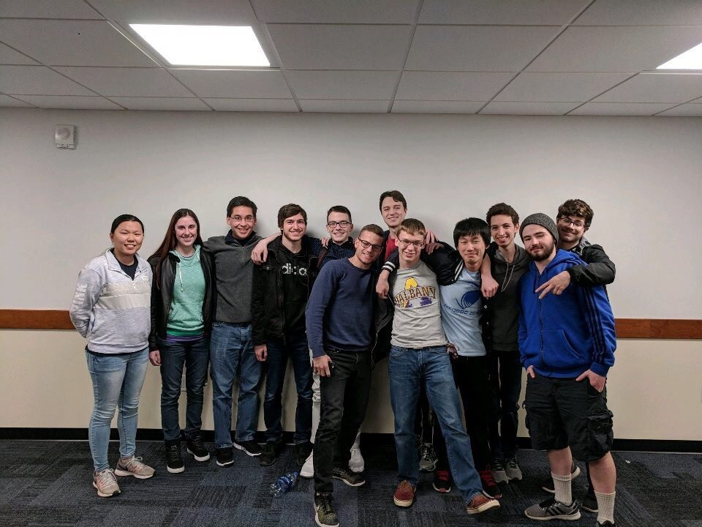
University at Buffalo Network Defense
Every semester we compete at a student run version of the competition run by a Buffalo.
Team A 1st Place
Team B 3rd Place

Slide 7
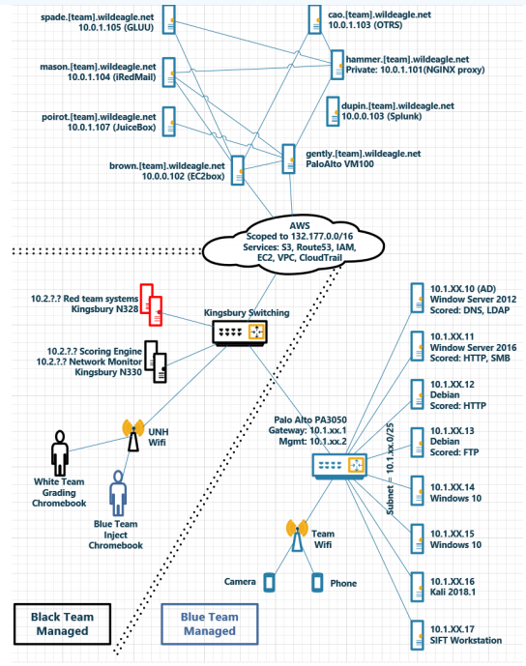
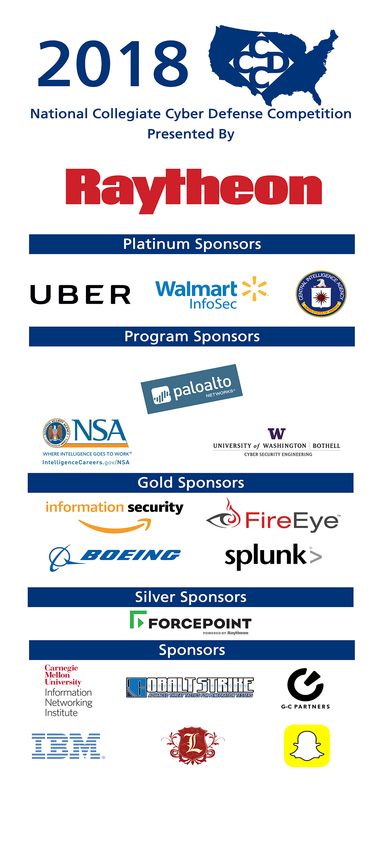

Slide 8
Free Stuff that you can have! (Plus more)
There are a lot of free things you have access to as a student!
Take advantage of them!

Slide 9
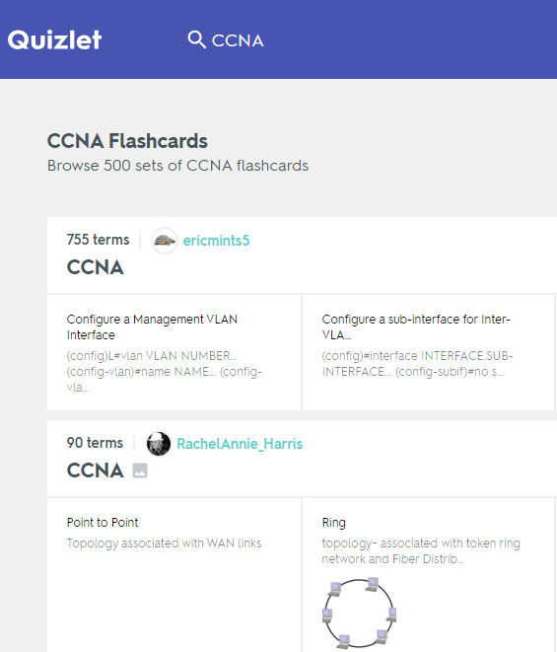
Online Training
If you have an NYPL Library Card, you have lynda.com
Free Cyber training - cybrary.it
Quizlet
Code Academy- codeacademy.com

Slide 10
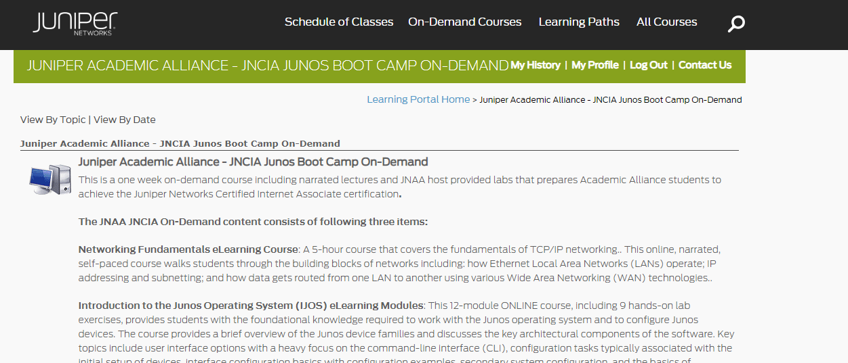
Networking - Juniper Networks
Email Damira Pon, Moni Moni-Nwinia mmnwinia@juniper.net

Slide 11
SIEMs
Splunk:
Training - https://www.splunk.com/en_us/training/free-courses/splunk-fundamentals-1
Product - Scale up to 500 MB data per day - https://www.splunk.com/en_us/software/pricing.html
SumoLogic
Training - https://www.sumologic.com/online-training/
Free Certs - https://www.sumologic.com/learn/certifications/
Premade environment - sumologic.com/wp-content/uploads/Labs-Using-Sumo-Security-Analytics.pdf

Slide 12
Cloud
AWS Cloud services
Has a very generous Free tier - Need a credit/debit card
IBM Cloud
Free plans is available
Multiple free plans with modules
Very fair
Example:
NLP
Chatbot
Webpage services
Etc.
Google Cloud Platform
$300 free when you first sign up.

Slide 13
Virtual Machines
Oracle VirtualBox- virtualbox.org
Uses .iso files to create a virtual environment that acts like a computer complete with its own operating system
Great for experimenting with new operating systems and networks

Slide 14
Linux Open Source
All sorts of Linux Open source are here:
https://www.linux.org/pages/download/

Slide 15
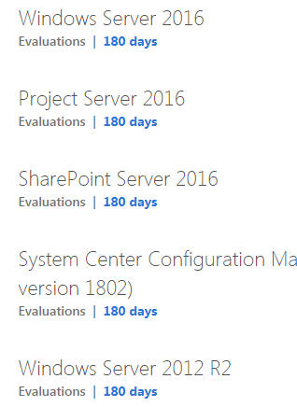
Free Windows
You can get Windows Server and Client Evaluation copies - https://www.microsoft.com/en-US/evalcenter/try

Slide 16

Firewall
Interest in firewalls?
Talk to Eric about details
Free firewall to practice with PFSense
Other Firewalls
Palo Alto - paid
Windows Firewall
Etc.
Website list of free firewalls:
More Firewalls

Slide 17
Capture the Flag Sites
https://www.hackthebox.eu/
https://www.vulnhub.com/
https://overthewire.org/wargames/
https://www.root-me.org/?lang=en

Slide 18
Certification
Anything CompTIA is respected.
Ask Tyler about the Security+
Ask Liam about the CySA+
Ask Eric or Anthony about Cisco Certifications (networking)
Ask Michael about federal security clearance.

Slide 19
Networking Certifications/Training (Paid)
CCENT/CCNA (Cisco)
HVCC offers courses
Practice exams/test need to pay
$500+
CompTIA Network+
Online website lists the exams
Training provided in online form: Ebooks & Online tool Certmaster
~$500

Slide 20
Forensic tool Certifications
ACE Certification
Need a fully licensed FTK tool to take the test
Free to take otherwise
EnCE Certification
Used in our classes with a bit more training and studying you can be ready for the certification
$200 to pay for the certification

Slide 21
Build your own homelab
The software stack Liam uses - https://hackernoon.com/the-open-home-lab-stack-5e5858722fee
Hardware - R710s are cheap right now. Check ebay.

Slide 22

Next Meeting - Intro To Information Security.
Next Friday, 3pm, BB008.
Please join our myInvolvement page! (It gets us a bigger budget. And more cool stuff for you guys).

